Slide 1
Project - Plain editor
Presented to -
Md. Mahbubul Islam Assistant Professor
Department of Computer Science and Engineering , University of Chittagong

Slide 2
Project - Plain editor
Coordinator – Arif Reza
Team Members -
Maifee Ul Asad(17701086)
Monjurul Hasan Sakeer(17701094)
Md Rizuan(17701100)
Sajib Kumar Das(17701030)
Md. Rashedul Alam Anik (17701105)
Department of Computer Science and Engineering , University of Chittagong

Slide 3
What is Plain Editor
Plain editor is a text editor .

Slide 4
> What is Plain Editor - Why custom text editor - basic features of a text editor > features of plain editor > architecture of plain editor - Explanation > Detailed features of plain editor - File Menu - Edit Menu - Format Menu - view Menu - Tools Menu - Help Menu > Why Plain editor > A few View of Plain editor > Question
Contents

Slide 5
Plain Editor -What is Text editor
A text editor is a type of computer program that edits plain text. Text editors are provided with operating systems and software development packages, and can be used to change configuration files, documentation files and programming language source code.

Slide 6
Plain Editor - Why custom text editor
Cause custom text editor offers us to get specifically the features we want . So we can concentrate on our work .

Slide 7
Plain Editor - basic features of a text editor
Find and replace
Cut, copy, and paste
Ability to handle UTF-8 encoded text
Text formatting
Undo and redo
Data transformation
Filtering
Syntax highlighting
Extensibility

Slide 9
features of plain editor
Find and replace
Cut, copy, and paste
Ability to handle UTF-8 encoded text.
Text formatting
Undo and redo
Syntax highlighting
WPM measurement
User-friendly reading mode
How JAVA works – Show Byte Code
Execute JAVA code
File recovery

Slide 10
Architecture of Plain editor
Main Memory
Input
-Key-board
-Mouse
Editing Component
Editing Buffer
Filters
Editing Filter
Command Processor
Viewing Filter
File System
Output
-Monitor
Display
Component
Viewing Buffer

Slide 11
Architecture of Plain editor - Explanation
First Plain Editor(PE) takes input from input(Key-board , Mouse) . Then it sends it to the command processor. This takes care of all of the commands - like what will happen when . Then it passes data to the editing components , this is where data internally takes new appearance . Now these all data put into a buffer . Through this buffer PE , talks with File System through Main Memory(RAM) . Main memory also works as the communicator of viewing filter and editing filter . Viewing filter then passes the data to the display component .For this case components are JAVA swing components . Then output are displayed to the output( Monitor)

Slide 12
Detailed features of plain editor
Features of PE is distributed in three parts .
- Menu bar
- Popup menu
- Keyboard shortcut
Some are in Menu-bar , some are in pop-up menu . Pop-up menu features are given to quickly access the features . Keyboard shortcut has been created for almost all the features , which are needed to be implemented quickly .

Slide 14
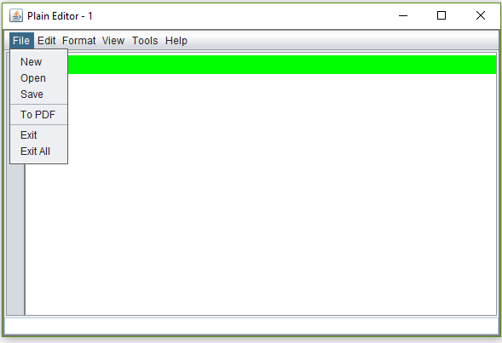
Detailed features of plain editor-File Menu
File Menu contains “New” , ”Open” , “Save” , ”To PDF” , "Exit" , "Exit All” command.

Slide 15
Detailed features of plain editor-File Menu
New command – This creates a new instance of PE, containing nothing .
Open command – This gives user the ability to open UTF-8 encoded files . Using a Input Stream Buffer this command is completed . Which includes JAVA, C/C++,Text and much more .
Save command – This gives user the ability to save file to disc, on a specific location and name .
Print command – This gives user the ability to print the content of PE of that instance . This converts documents to PDF , then it prints documents .
Exit command – This command exit the specific instance of PE.
Exit All command – This command exit all instance of PE.

Slide 16
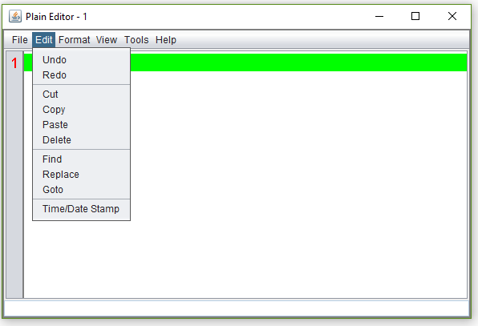
Detailed features of plain editor-Edit menu
Edit Menu contains – “Undo”, “Redo" , "Cut" , "Copy" , "Paste" , "Delete" , "Find" , "Replace" , "Go to" , "Time/Date Stamp” .

Slide 17
Detailed features of plain editor-Edit menu
Undo command – This command uses JAVA swing Undo Listener , this gives a smooth undo command execution .
Redo command – Like Undo command this command uses JAVA swing’s Undo Listener , this also gives smooth and fast redo.
Cut command – This cut the specifically selected text from the PE and puts it into system clipboard for further uses .
Copy command – This copies the specifically selected text form the PE and puts it into the system clipboard for further uses .
Paste command – This paste data from system clipboard to the PE , where mouse caret is placed .

Slide 18
Detailed features of plain editor-Edit menu
Find command – PE uses find as user type method . It can find and mark 100 million keyword within second , on any standard computer . Find command is also equipped with is word and match case methods .

Slide 19
Detailed features of plain editor-Edit menu
Replace command – This command replace specific keyword via one click or it gives user to select a or multiple instance then , replace it . It is also equipped with is word and match case method . During replacing procedure it also shows all the keyword highlighted , so user gets a better view . It also has go to next and go to previous method .
Go to command – This command is mainly for huge documents , but user can use it anywhere . Using this user can go to an specific line .
Time/Date Stamp command – This puts a time/date stamp into PE .

Slide 21
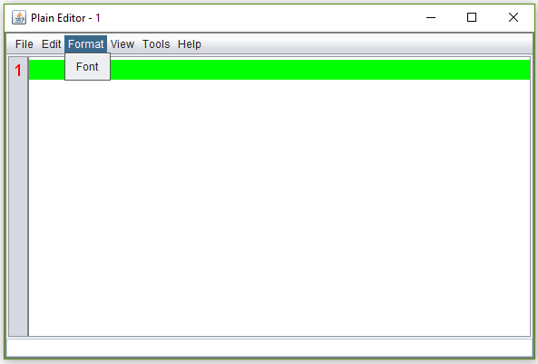
Detailed features of plain editor-Format menu

Slide 22
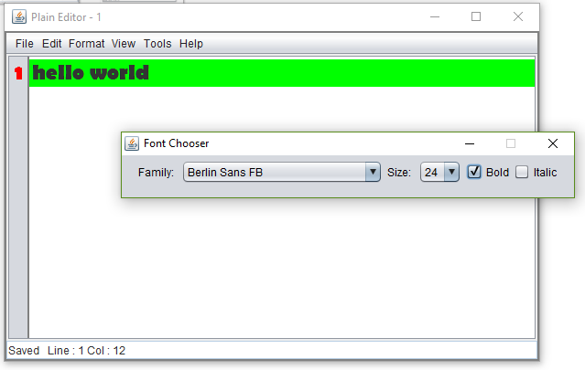
Detailed features of plain editor-Format menu
These menu contains least feature but one of the most important feature .
Font command – This gives the user the power to choose font from a huge range of collections . There is also font size selecting options and italic/bold options .

Slide 23
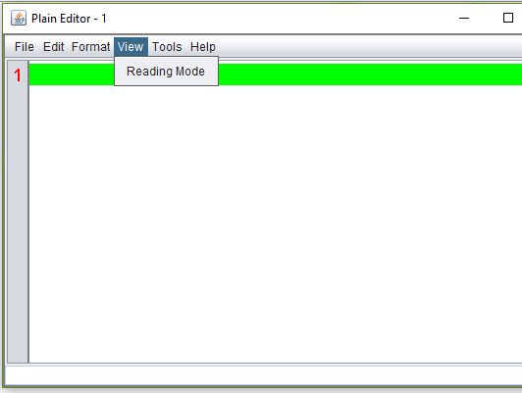
Detailed features of plain editor-view menu

Slide 24
Detailed features of plain editor-view menu
Reading Mode command – This command disable/enable PE’s editing capability . So user can focus on reading in a rusty condition .

Slide 25
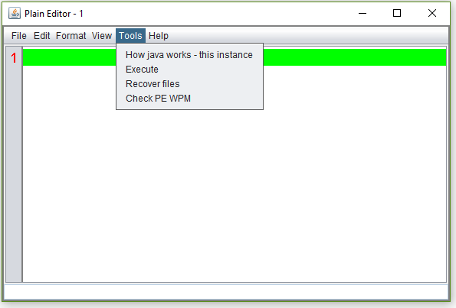
Detailed features of plain editor-tool menu

Slide 26
Detailed features of plain editor-tool menu
How JAVA works – this instance command – This is one of the interesting features of PE. This shows user the byte code of the given code . So user can have a better knowledge of how things happens inside JVM.
Execute command – This gives the user the power to execute his/her code . After execution is done , he/she can type “exit()” without the quotes and exit from there .
Recover files – We don’t have closing warning , because we care about user and save user’s file silently . So due any rusty situation like PC crash user doesn’t have the chance to lose files.
PE WPM – This is feature to give user outline of his/her typing skill.

Slide 28
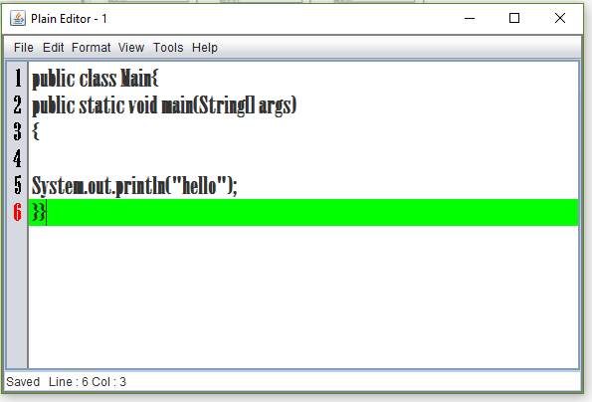
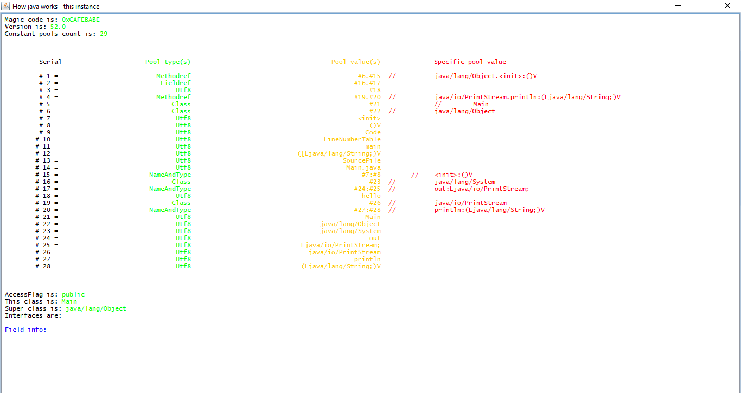
Detailed features of plain editor-tool menu

Slide 29
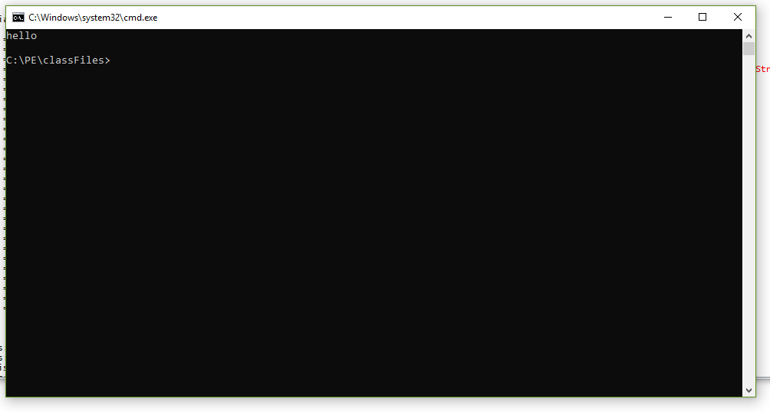
Detailed features of plain editor-tool menu

Slide 30
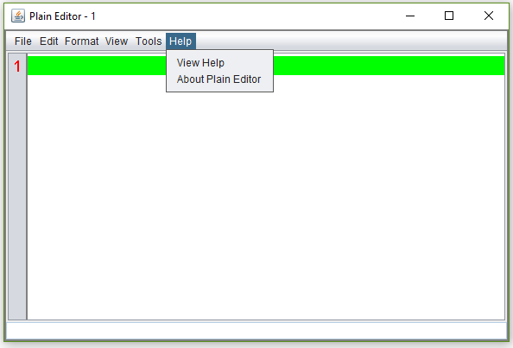
Detailed features of plain editor - HElp menu

Slide 31
Detailed features of plain editor - HElp menu
View Help command – This shows the shortcut keys and where specific command’s are set .
About Plain editor command – This shows who we are .

Slide 33
Why plain editor
Although PE doesn’t contains a few functions , PE is very lite , it is fast , easy to use , lesser almost near to zero crashing chance , why not Plain Editor ?

Slide 34
Questions

